Slide 1



Rotary

Slide 2
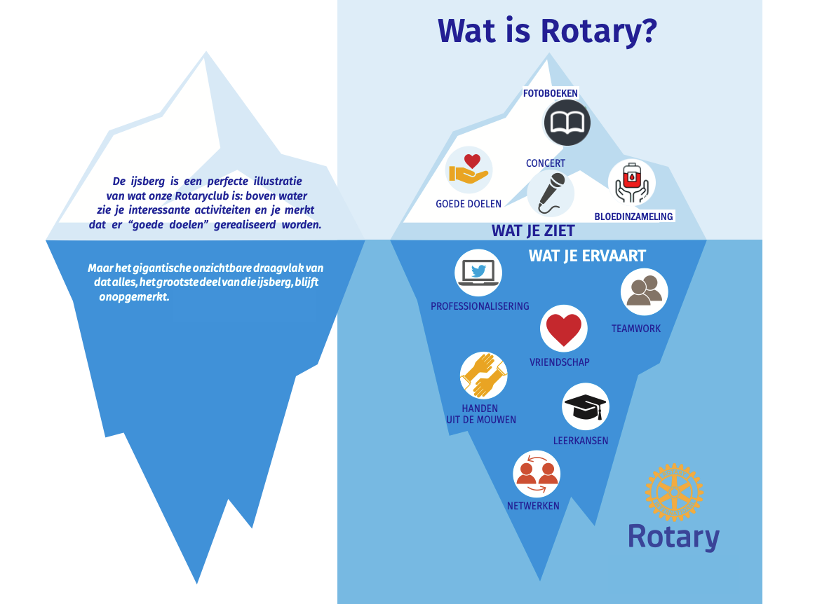

Slide 3


Slide 4
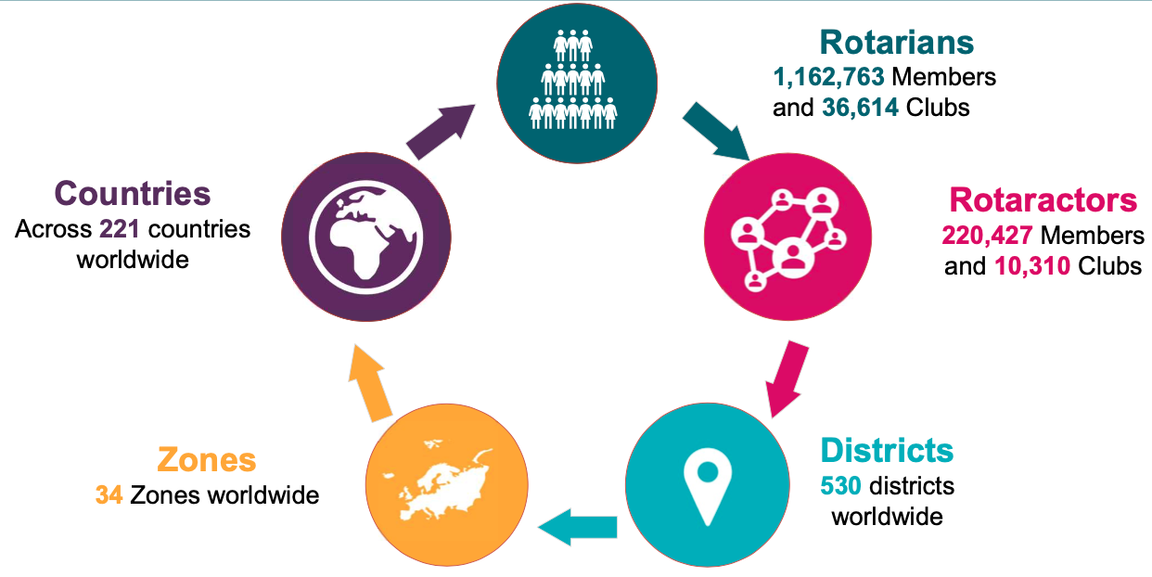
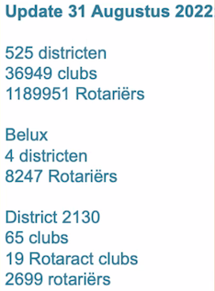
ROTARY’S INTERNATIONAL NETWORK WORLDWIDE

Slide 5
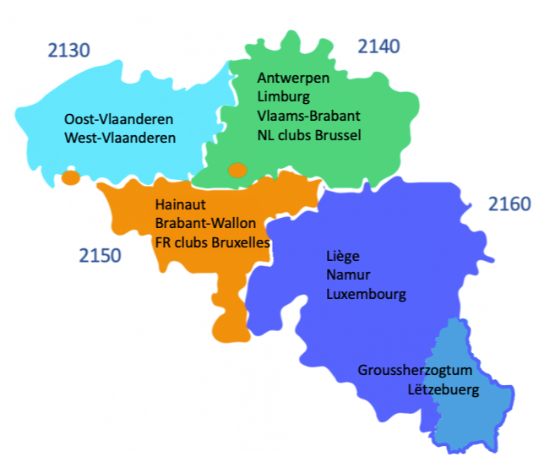


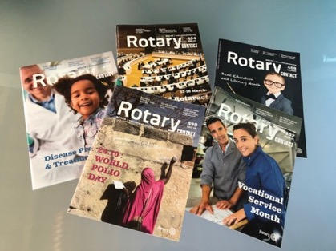
RBS Driven by 4 Districts
D - 2140
RBS (Rotary Belux Services)
voor de 4 DISTRICTS
www.rotarybelux.org/
D - 2130
D - 2150
D - 2160

Slide 6




Foundation
Donating to the foundation is Rotarian solidarity
World Fund
PolioPlus Fund - more
Disaster Response Fund
Rotary Peace Centers
Endowment Fund
Rotary solidariteit
streefdoel voor clubs
100$/lid => World Fund
40$/lid => Polio Fund
charity navigator

Slide 7
Rotary Action Groups (RAG)
Rotary Action Groups
by area of focus
Promoting peace
Domestic Violence Prevention
Peace
Refugees
Slavery Prevention
Fighting disease
Addiction Prevention
Alzheimer's/Dementia
Blindness Prevention
Blood Donation
Diabetes
Family Health/AIDS Prevention
Health Education and Wellness
Hearing
Hepatitis Eradication
Malaria
Mental Health
Multiple Sclerosis
Polio Survivors
Providing clean water and sanitation
Menstrual Health and Hygiene
Water, Sanitation and Hygiene
Saving mothers and children
Clubfoot
Reproductive Maternal and Child Health
Supporting education
Basic Education and Literacy
Growing local economies
Community Economic Development
Disaster Assistance
Protecting the environment
Endangered Species
Environmental Sustainability
Action groups that work in more than
one area of focus
Food Plant Solutions
Rotary Action Groups are independent, Rotary-affiliated groups made up of people from around the world who are experts in a particular field, such as economic development, peace, addiction prevention, the environment, or water

Slide 8
Rotary Fellowships
Honorary Consuls
Horseback Riding
Hunting
Internet
Italian Culture
Jazz
Kites
Latin Culture
Lawyers
Leadership
LGBT+
Magicians
Magna Graecia
Marathon Running
Metalhead
Military Veterans
Motorcycling
Music
Old and Rare Books
Palmwine
Past District Governors
Peace Fellows
Photographers
Pickleball
Public Health
Cycling
Doll Lovers
Draughts (Checkers)
E-Clubs
Editors and Publishers
Educators
Empowering Women
Entrepreneurs
Esperanto
Ethics
European Philosophy
Executive Managers
Fishing
Flying
Genealogists
Gin
Global Development
Go
Golf
Gourmet Cooking
Graphic Designers
Healthcare Professionals
Hiking
Home Exchange
Quilters and Fiber Artists
Recreational Vehicles
Railroads
Rotary Global History
Rotary Means Business
Rotary on Pins
Rotary on Stamps
Rowing
Rum
Scouting
Scuba
Shooting Sport
Singles
Skiing
Social Networks
Strategic Planning
Surfing
Table Tennis
Tennis
Total Quality Management
Travel and Hosting
Triathlon
Urban Gardening
Vintage Collectables
Wellness and Fitness
Fellowships
4x4 vehicles
Alsace
Amateur Radio
Antique Automobiles
Argentine Culture
Badminton
Bathhouse
Beard and Moustache
Bee
Beer
Bird Watching
Bowling
Camping
Caravanning
Chess
Comedy
Computer Users
Corporate Social Responsibility
Cricket
Cruising
Cultural Heritage
Curling
Rotary Fellowships are international groups that share a common passion. Being part of a fellowship is a fun way to make friends around the world, explore a hobby or profession, and enhance your Rotary experience.
Whisk(e)y
Wildlife Conservation
Wine
Yachting
Yoga

Slide 9

Driven by Rotary International
ICC Inter Country Comity
Rotary volunteers
Rotary Friendship Exchange :
  leden en vrienden die om beurten ontvangen in hun huizen en clubs (meestal district naar district)
International RI Partners
  Shelterbox
    ShelterBox was founded in the small town of Helston, Cornwall UK, by the Rotary Club of Helston-Lizard in 2000

Slide 10
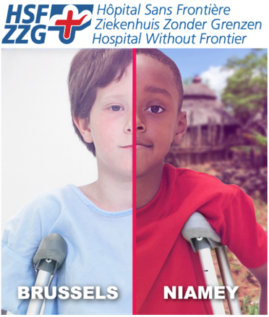


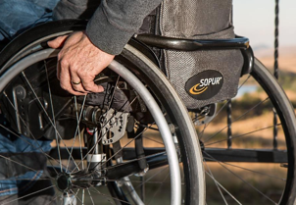
Driven by Rotarians ( not RI, Not district )
Initiatieven in BeLux gedreven door individuele Rotariërs.
Ziekenhuis Zonder Grenzen
NVSG Nationale Vereniging tot Steun aan Gehandicapten
Hoofdzaak er is Hoop
Rotary clubs for Development

Slide 11

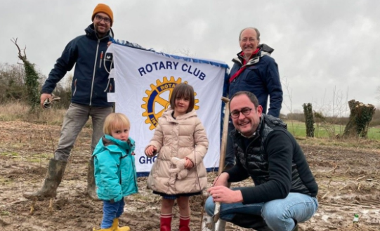
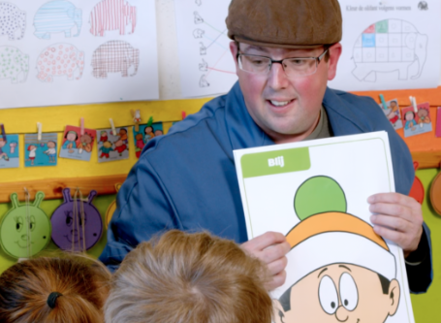
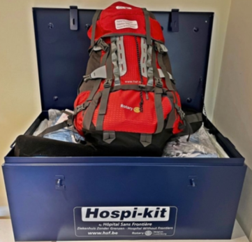
Ons district
D2130 initiatieven door clubs
Scholen zonder pesten
River Cleanups
Plant een boom
HospiKits

Slide 12
werkgroepen
fondsenwerving
gemeenschapsdienst
leefmilieu
jeugdactie
ledenbeheer
internationale actie
PR & communicatie
beroepsactie
Rotary Foundation

Slide 13
Topics | Waar te vinden (online)
Lidmaatschap; peterschap | https://www.rotary.org/en/about-rotary/membership
clubgids | https://drive.google.com/file/d/1pdw9-fglyKURIhxBm38n6DuzT0EVgoYA/view?usp=sharing
Polaris: club – district – andere clubs | https://gent-noord.rotary2130.org/nl
Rotary Contact magazine | http://rotarycontact.rotarybeluxservices.org/
Doel, Ethiek, 4 Vragen, Avenues of service | https://my.rotary.org/en/guiding-principles
Structuur: Districten, zones, gouverneur | District: https://rotary2130.org/nl/
Ons district op Google maps: clubs: | https://www.google.com/maps/d/u/1/viewer?ll=51.07836938077328%2C3.439616092827462&z=10&mid=17odEG2B_6oB7e4u8K3olmlCFtGOeBK3g
internationaal: | https://www.rotary.org/en
contactclub: Alphen-aan-de-Rijn | https://www.rotary.nl/alphenaandenrijn/
jeugduitwisselingen | https://www.rotary.org/en/our-programs/youth-programs
Rotary Foundation | https://www.rotary.org/en/about-rotary/rotary-foundation
Polio | https://www.endpolio.org/
Afkortingen | https://rotary2130.org/nl/content/various/show/10983
Agenda van andere clubs in het district | https://rotary2130.org/nl/agenda/other-clubs?criteria%5BendsAt%5D=latest

Slide 14


